Slide 1
Seminar Research
汇报人：袁尤良
日期：2021/06/16

Slide 2
Introduction of Audio
Prosody
Speech Semantic
Current Work

Slide 3
Introduction
语音方面的基本概念 基本概念（分帧，帧移，加窗，预加重...) 常用声学特征（语谱图，MFCC， FBlank， PLP... )
部分语音信号处理工具 声学特征提取软件 强制对齐软件

Slide 4
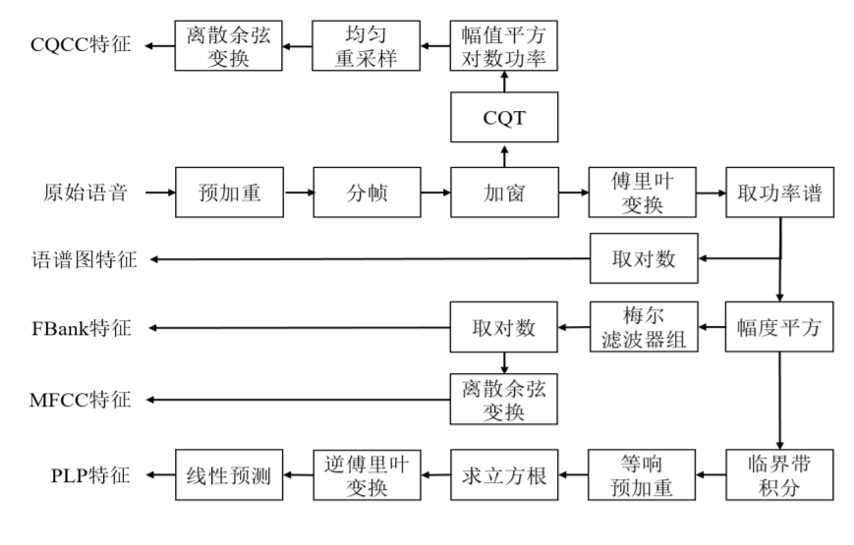
Introduction

Slide 5
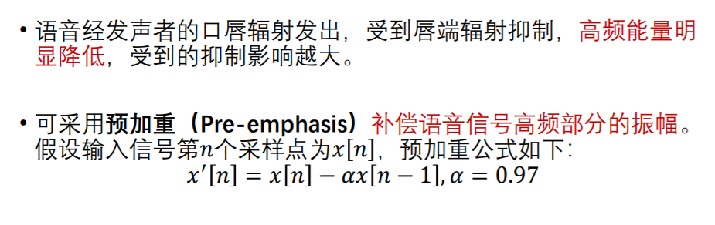
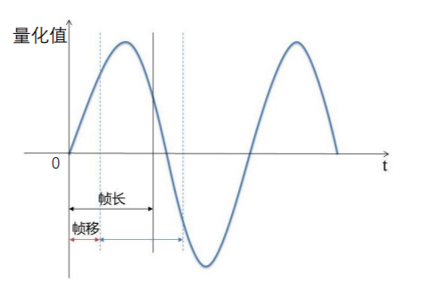
预加重
要求：
帧内平稳
包含足够多振动周期
分帧，帧移
20-50ms

Slide 6
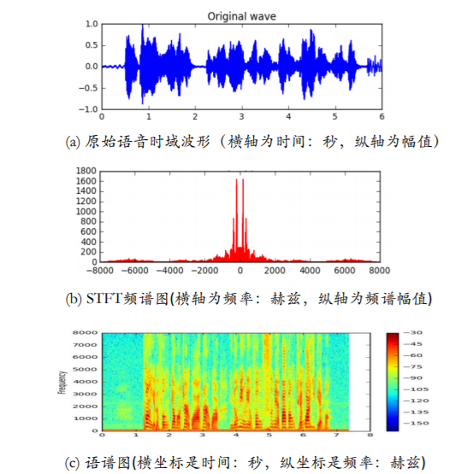
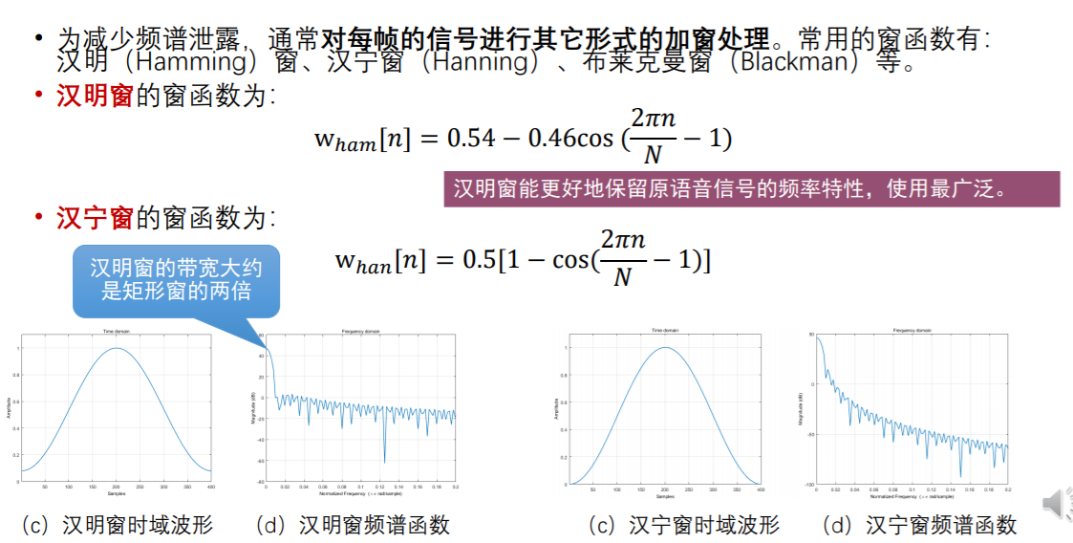
Introduction
时域，频域，语谱图
加窗

Slide 7
Introduction
语音方面的基本概念 基本概念（分帧，帧移，加窗，预加重...) 常用声学特征（语谱图，MFCC， FBlank， PLP... )
部分语音信号处理工具 声学特征提取软件 强制对齐软件

Slide 8
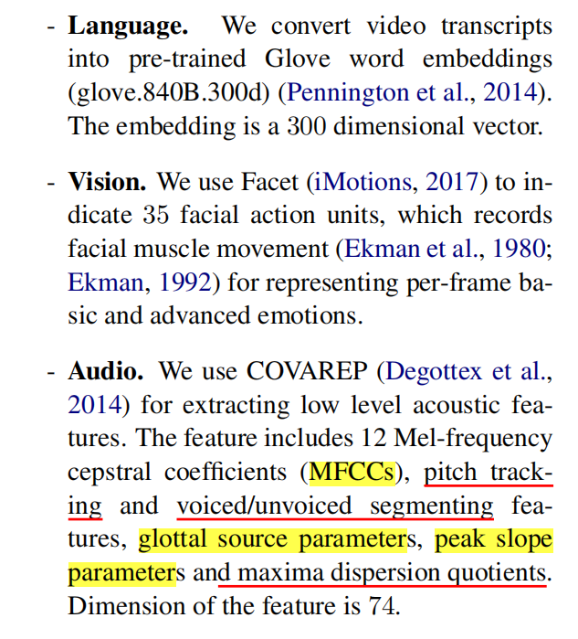
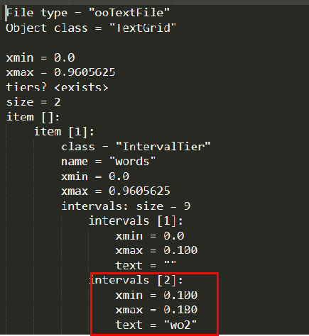
Introduction
声学特征提取软件：COVAREP, LIBROSE
强制对齐： MFA， P2FA
现有：COVAREP
The feature includes：
12 Mel-frequency cepstral coefficients (MFCCs)
pitch tracking
voiced/unvoiced segmenting features
glottal source parameters
peak slope parameters
maxima dispersion quotients

Slide 9
Introduction of Audio
Prosody
Speech Semantic
Current Work

Slide 10
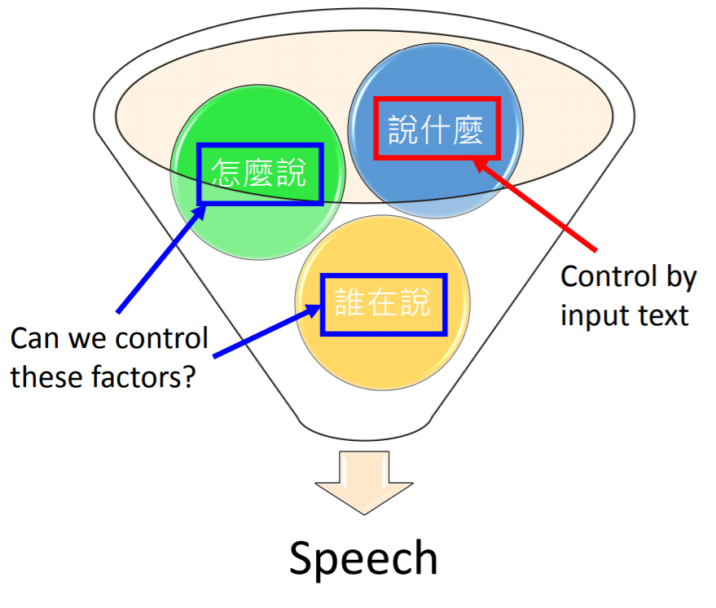
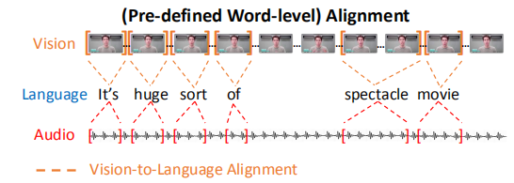
如果能够将语音中相对文字的冗余信息去除掉，是否会对两个模态的融合更加友好

Slide 11
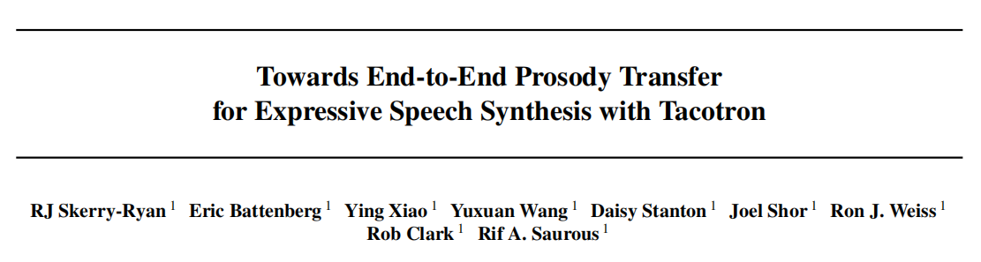
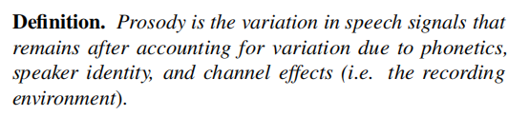
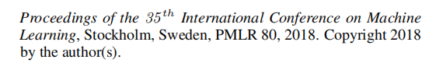
Prosody的相关研究
提出了Prosody的概念
提出了一些简单的评价指标
Notes:
Although Deep Learning models have show their power in NLU, these models still require abundant labeled training data.
But for new domains, there are only a few samples. Thus, fewshot learning(Fei-Fei et al., 2006; Lake et al., 2015; Vinyals et al., 2016) has received more and more attention in rencent years (Fritzler et a;., 2019; Geng et al., 2019; Hou et al., 2020). These approaches extract transferable knowledge among old domains and transferred to new domains quickly with few examples

Slide 12
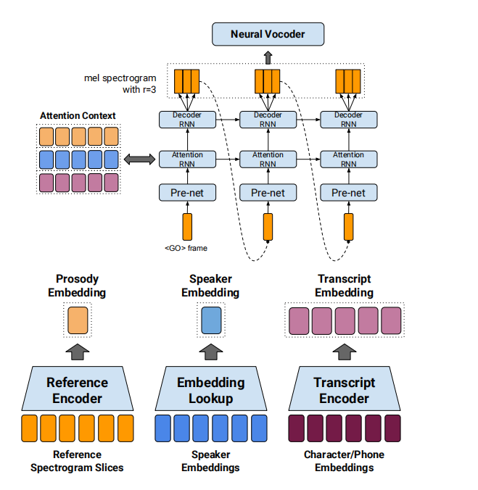
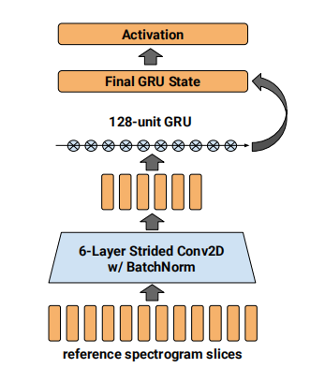
Prosody的相关研究
Reference Encoder
Notes:
Although Deep Learning models have show their power in NLU, these models still require abundant labeled training data.
But for new domains, there are only a few samples. Thus, fewshot learning(Fei-Fei et al., 2006; Lake et al., 2015; Vinyals et al., 2016) has received more and more attention in rencent years (Fritzler et a;., 2019; Geng et al., 2019; Hou et al., 2020). These approaches extract transferable knowledge among old domains and transferred to new domains quickly with few examples

Slide 13
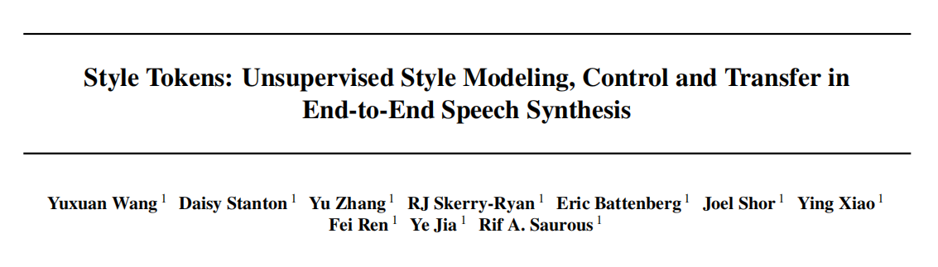
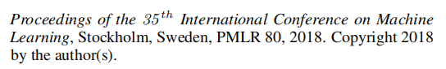
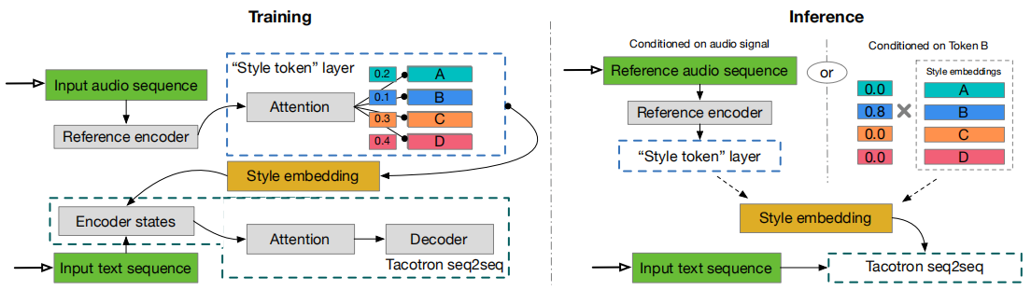
Prosody的相关研究
Factorizes the prosody embedding with several global style tokens(GST)
Notes:
Although Deep Learning models have show their power in NLU, these models still require abundant labeled training data.
But for new domains, there are only a few samples. Thus, fewshot learning(Fei-Fei et al., 2006; Lake et al., 2015; Vinyals et al., 2016) has received more and more attention in rencent years (Fritzler et a;., 2019; Geng et al., 2019; Hou et al., 2020). These approaches extract transferable knowledge among old domains and transferred to new domains quickly with few examples

Slide 14
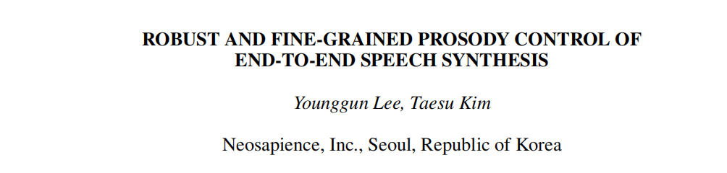
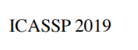
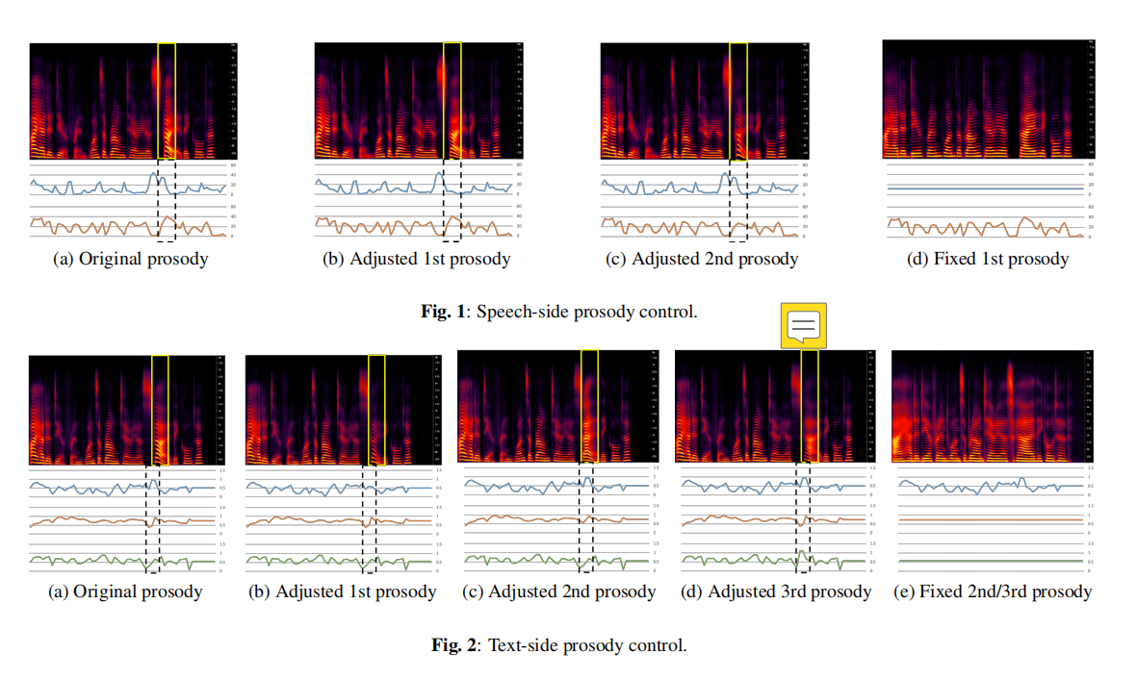
Prosody的相关研究
Fine-grained control of the speaking style of synthesized speech.
Extract frame-level prosody information and uses an attention module to align it with each phoneme encodings.
Notes:
Although Deep Learning models have show their power in NLU, these models still require abundant labeled training data.
But for new domains, there are only a few samples. Thus, fewshot learning(Fei-Fei et al., 2006; Lake et al., 2015; Vinyals et al., 2016) has received more and more attention in rencent years (Fritzler et a;., 2019; Geng et al., 2019; Hou et al., 2020). These approaches extract transferable knowledge among old domains and transferred to new domains quickly with few examples

Slide 15
实验结果：不 work
原因分析：
数据集的大小问题
数据的不纯净（语音合成中使用的音频更加干净）
Prosody embedding的维度问题

Slide 16
Introduction of Audio
Prosody
Speech Semantic
Current Work

Slide 17
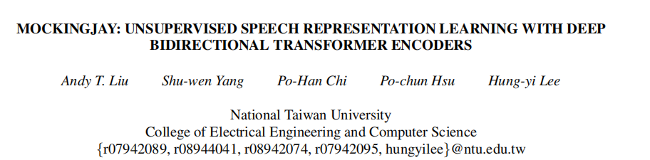
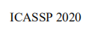
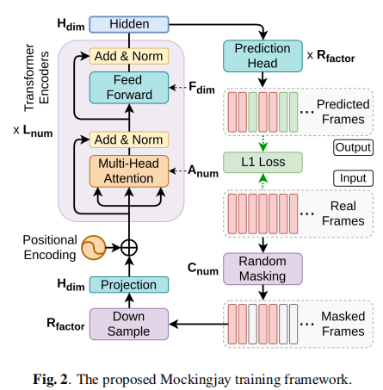
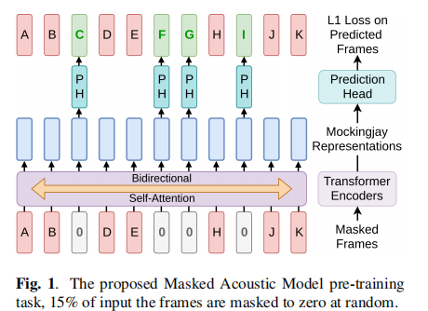
frame level的MLM

Slide 18
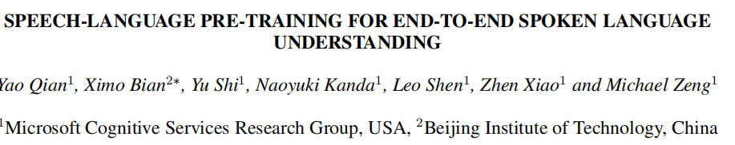
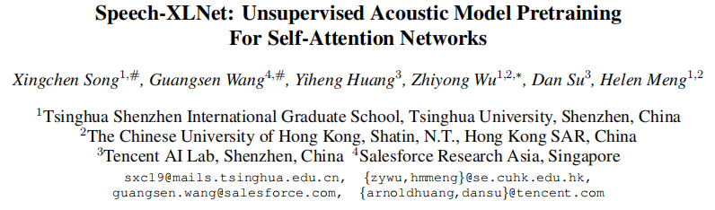
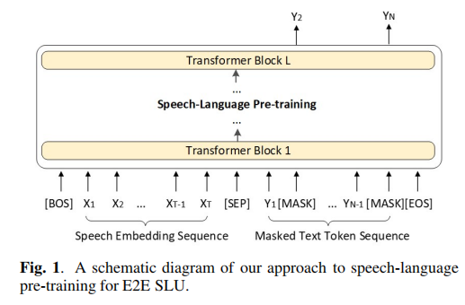
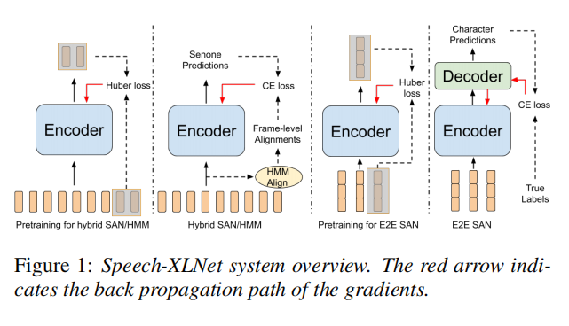

Slide 19
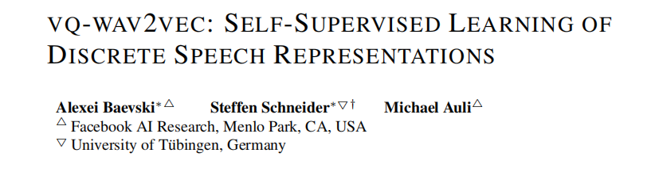
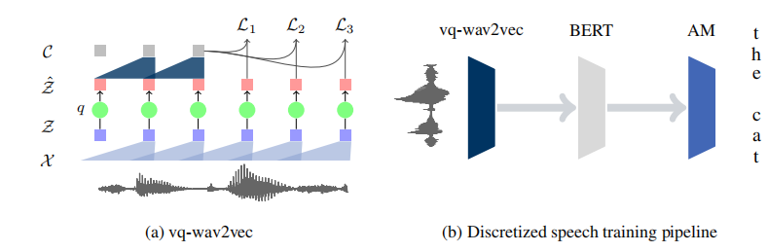

Slide 20
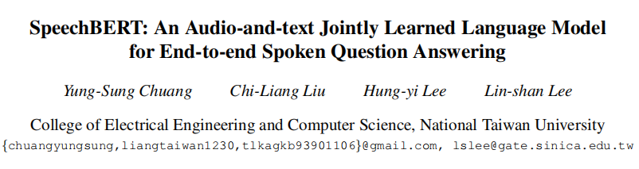
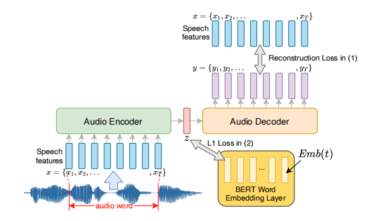
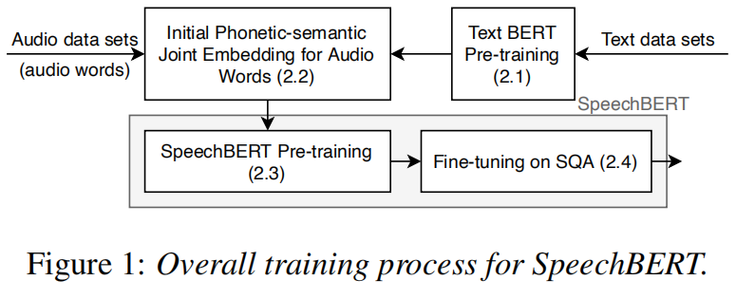
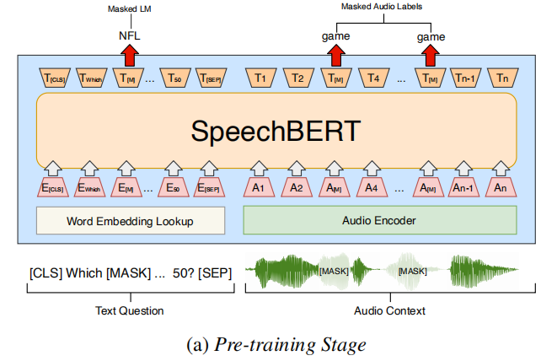
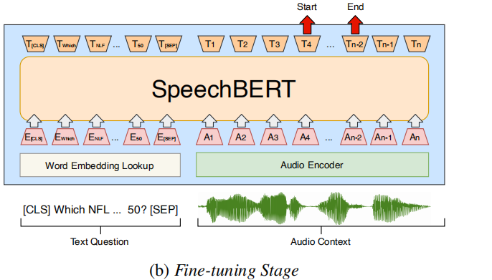

Slide 21
两种思路：
不依赖文字，将帧看成单位，利用大量语音语料预训练
先转换成文字，然后利用强制对齐将语音分片
我们的目的：
语音可以有不同于文字的更丰富的信息，因此如果能够得到有语义的语音将大有可为
难点：
想到达到上述目标，意味着我们的模型需要有很强的invariance的能力，这个似乎很难达到，哪怕是安静环境下的语音识别在面对丰富prosody的语音也力有不逮

Slide 22
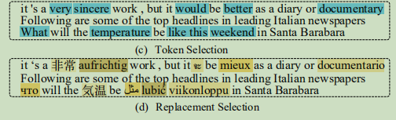
switch code

Slide 23
实验：
数据集：中文aidatatang_200zh（一个语音识别的数据集）
任务： Mask Language Model Task
模型结构： 利用一个RNN充当bert的语音embedding layer，逐步提升语音替换文字的比例
效果：不如用拼音，远达不到期望中的让语音带上语义
分析：
可能RNN编码audio在这里有局限性？
本任务已经做了很多简化，在实际情况可能会存在以下问题：
语音识别出错，导致语音切片存在问题
现实任务往往很难有同一个人的大量数据，往往是很多人，每人一小段时间的语音
许多时候数据会存在背景声，以及同一个词在多种环境下的不同发音，时长等，不确定能用一个RNN很好地学出来

Slide 24
Introduction of Audio
Prosody
Speech Semantic
Current Work

Slide 25
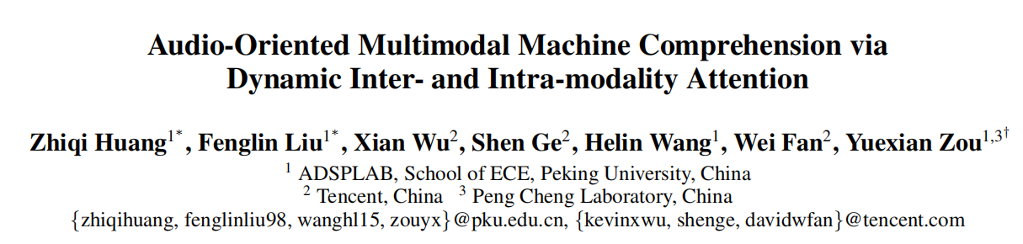
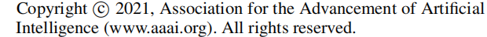
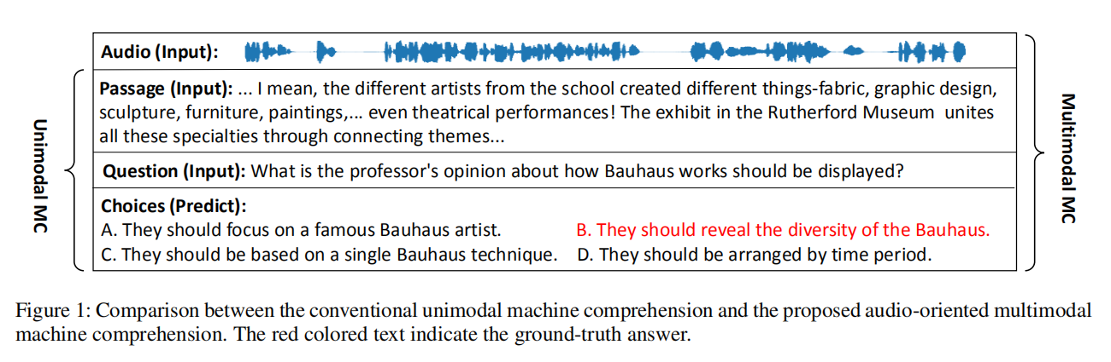
现有语音相关多模态研究
Notes:
Although Deep Learning models have show their power in NLU, these models still require abundant labeled training data.
But for new domains, there are only a few samples. Thus, fewshot learning(Fei-Fei et al., 2006; Lake et al., 2015; Vinyals et al., 2016) has received more and more attention in rencent years (Fritzler et a;., 2019; Geng et al., 2019; Hou et al., 2020). These approaches extract transferable knowledge among old domains and transferred to new domains quickly with few examples

Slide 26
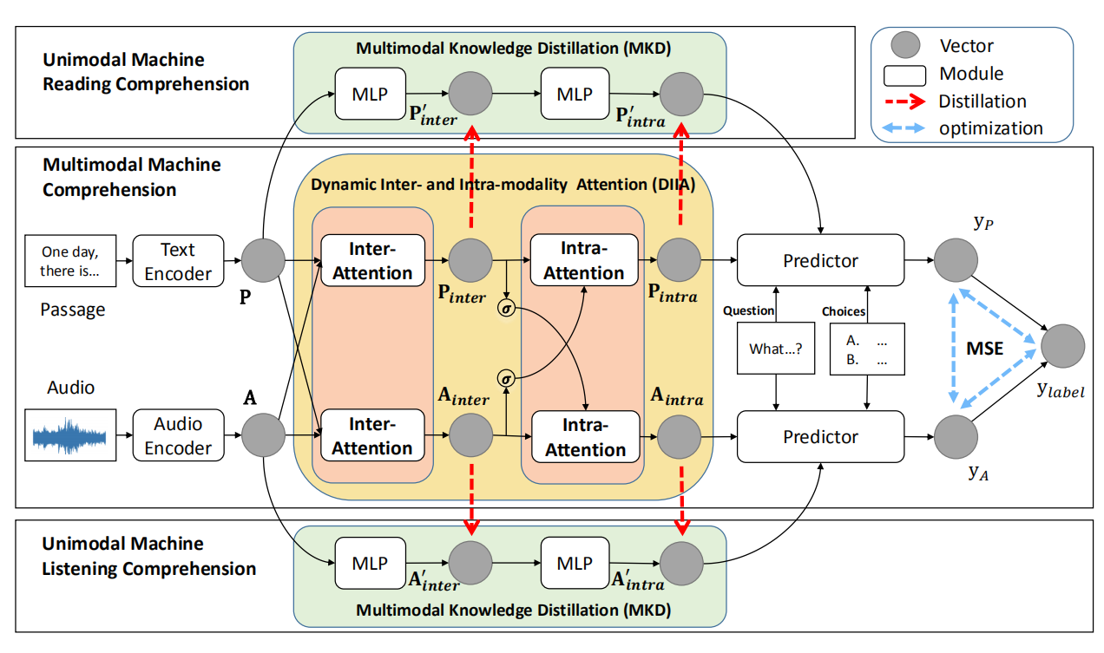
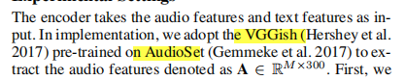
现有语音相关多模态研究
Notes:
Although Deep Learning models have show their power in NLU, these models still require abundant labeled training data.
But for new domains, there are only a few samples. Thus, fewshot learning(Fei-Fei et al., 2006; Lake et al., 2015; Vinyals et al., 2016) has received more and more attention in rencent years (Fritzler et a;., 2019; Geng et al., 2019; Hou et al., 2020). These approaches extract transferable knowledge among old domains and transferred to new domains quickly with few examples

Slide 27
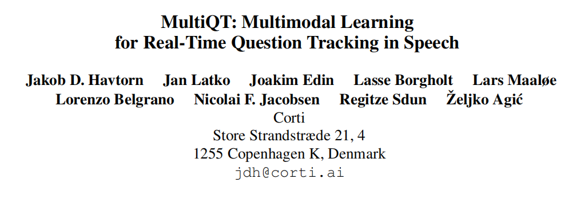
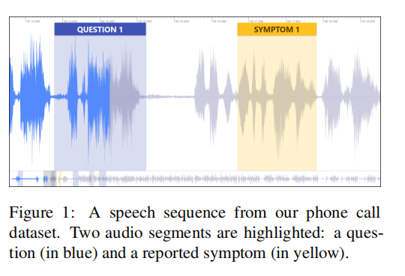
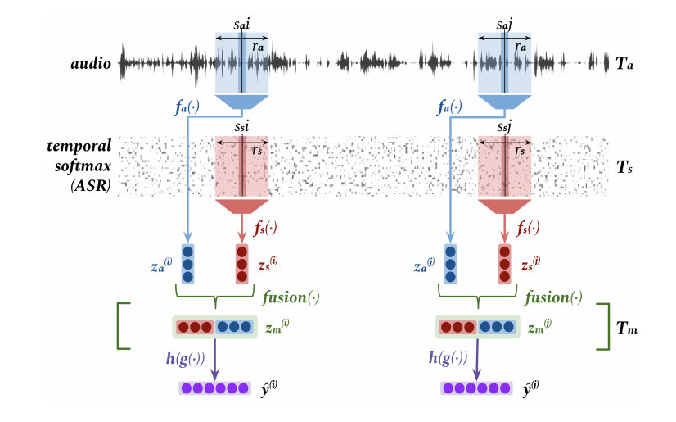
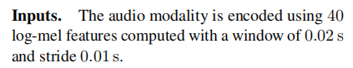
现有语音相关多模态研究
Notes:
Although Deep Learning models have show their power in NLU, these models still require abundant labeled training data.
But for new domains, there are only a few samples. Thus, fewshot learning(Fei-Fei et al., 2006; Lake et al., 2015; Vinyals et al., 2016) has received more and more attention in rencent years (Fritzler et a;., 2019; Geng et al., 2019; Hou et al., 2020). These approaches extract transferable knowledge among old domains and transferred to new domains quickly with few examples

Slide 28
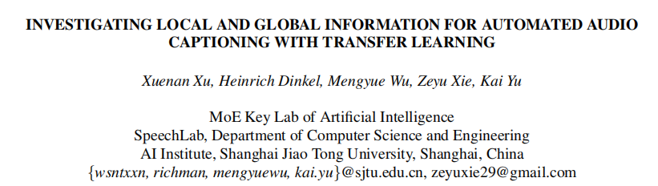
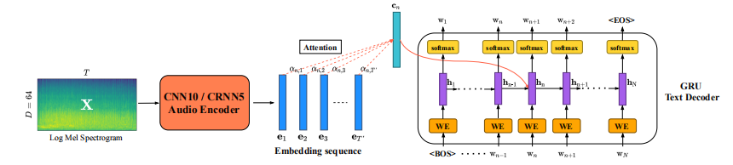
现有语音相关多模态研究
这样的做法存在问题
Notes:
Although Deep Learning models have show their power in NLU, these models still require abundant labeled training data.
But for new domains, there are only a few samples. Thus, fewshot learning(Fei-Fei et al., 2006; Lake et al., 2015; Vinyals et al., 2016) has received more and more attention in rencent years (Fritzler et a;., 2019; Geng et al., 2019; Hou et al., 2020). These approaches extract transferable knowledge among old domains and transferred to new domains quickly with few examples

Slide 29
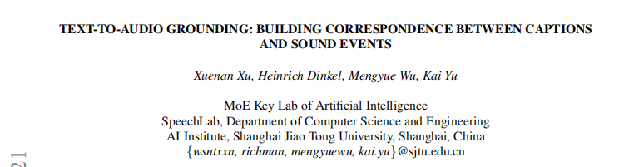
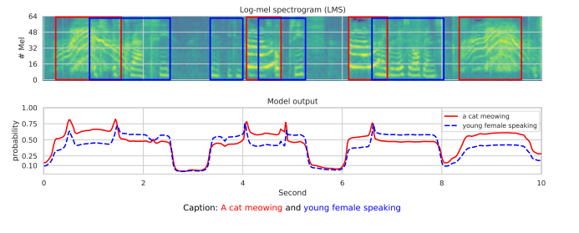
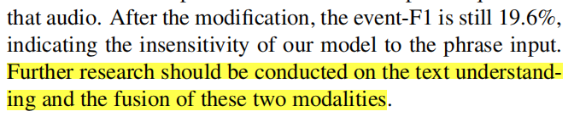
尝试从audio和text的融合切入做一些工作，希望搞清楚最大的问题在哪

